Slide 1

Project Proposal: Loan Approval Prediction Using Machine Learning
Team Contributors include Maryann Grace, Tyquese Taplin, Isaiah Rollie, Logan Dameron, Metaferya Fitsum, Inshirah Khatib, Cordette Gillis & Charles Williams

Slide 2
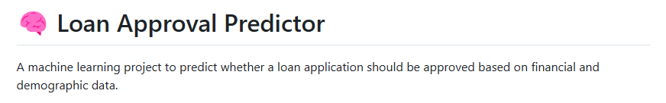
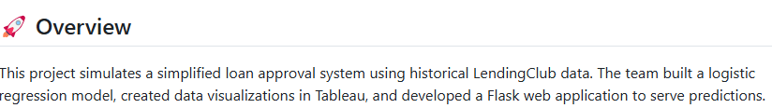
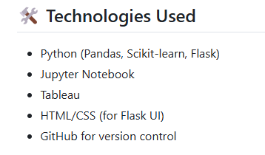

Slide 3

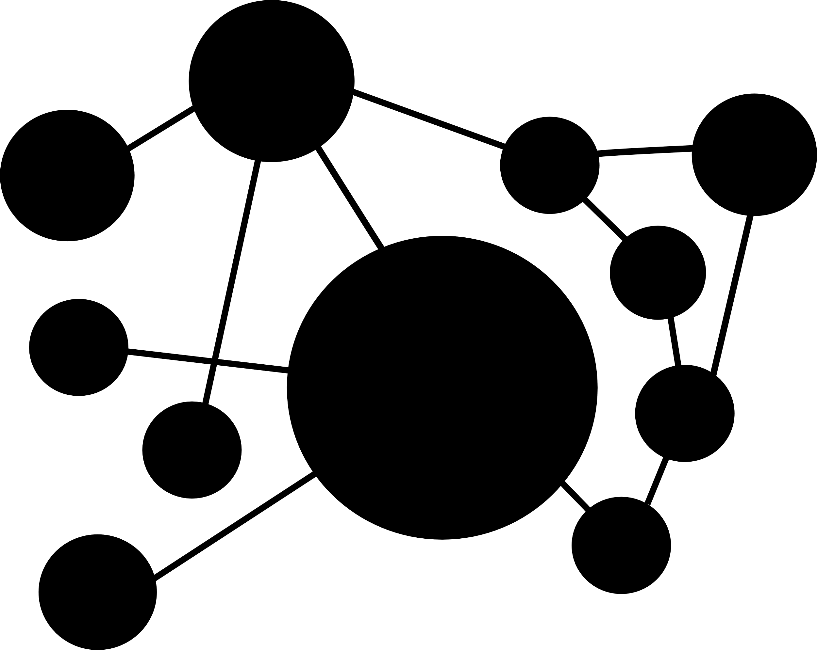

Main Objective
To build a machine learning model that predicts whether a loan application should be approved (binary: Yes/No) based on borrower financial and demographic details. The goal is to simulate a data-driven loan evaluation system that mirrors the decision-making process of real-world lenders. By analyzing features like income, credit history, loan amount, and employment status, the model will help identify approval likelihood and highlight key contributing factors.
Y

Slide 4
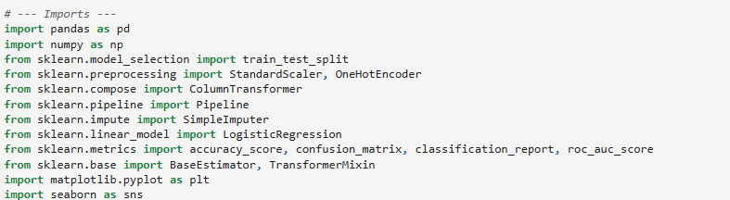
Imports used to create Model

Slide 5
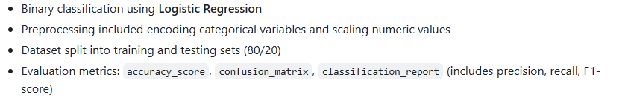

Slide 6

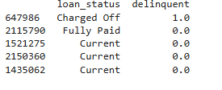
Data Cleaning
The accepted data in the CSV sample utilized information such as, customers delinquent payment status, and history. The various time frames were from (16-30 days late), (31-120 days late) and lastly charge offs, dataset of created output displayed below.
This Photo by Unknown Author is licensed under CC BY-SA

Slide 7
Relevant Columns in the Data Set
Loan amount
Term of mortgage
Interest Rate
Credit Grade/ Sub Grade
Employment Length
Annual Income
Purpose
Verification Status
Loan Status Target

Slide 8
Intended Deliverables
Our final deliverable will include:
° A trained machine learning model that predicts loan approval (Yes/No) ° An interactive web interface built with Flask, allowing user input and displaying real-time predictions ° Visualizations using Matplotlib, Plotly, or hvPlot ° Supporting documentation, Jupyter notebooks, and evaluation results ° A presentation summarizing objectives, process, and results ° This deliverable meets assignment requirements by using a real dataset with 100+ records, applying Scikit- learn, and incorporating Pandas with at least one visualization library (Matplotlib, Plotly, or hvPlot)

Slide 9
Loan Data Set for Training Model
 | 0 | 1 | 2 | 3 | 4
id | 112575999 | 122347826 | 133439083 | 119216681 | 142845437
issue date | 7/1/2017 | 11/1/2017 | 6/1/2018 | 10/1/2017 | 10/1/2018
loan amt | 35000 | 12100 | 17000 | 12000 | 14000
term | 60 | 36 | 36 | 60 | 36
installment | 851.51 | 467.83 | 533.5 | 327.69 | 426.61
emp length | 9 | 4 | 4 | 10+ | 4
home ownership | rent | mortgage | mortgage | rent | mortgage
annual income | 175000 | 106000 | 65000 | 60000 | 57000
verification status | verified | not verified | source verified | verified | source verified
purpose | other | debt cons | credit card | det cons | debt cons
address state | CA | VA | CA | AZ | CA
dti | 13.51 | 27.47 | 12.78 | 26.6 | 10.74
delinquent 2 yrs | 0 | 0 | 0 | 0 | 0
fico range low | 710 | 670 | 700 | 660 | 685
fico range high | 714 | 674 | 704 | 664 | 689
inq last 6 mths | 0 | 0 | 1 | 2 | 0
delinquent | 1 | 0 | 0 | 0 | 0

Slide 10
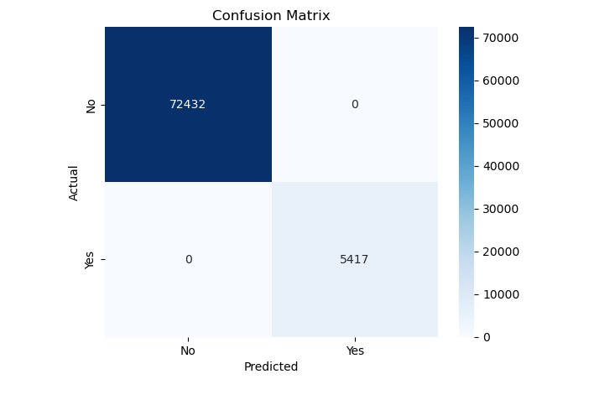
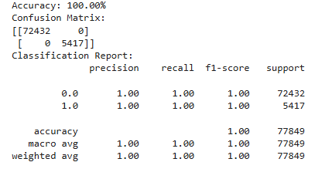
Trained Model
The trained test model created a Classification Report aka “Confusion Matrix” giving us an accuracy: 100.00%

Slide 11
Conclusion
Our team created a model for businesses that want to analyze the projected customer need for various mortgage products. The target audience consists of buyers who are ready, willing, and able to purchase a property. The term property broadly refers to but isn’t limited to things such as a commercial building, a primary residence, an investment property, or land. This project focuses on the accuracy of credit scores, the classification report of the borrower, showcases the confusion matrix, and other facets of the mortgage process. This model will help companies quickly assess a borrower’s availability to purchase a property.

Slide 12
Dataset
Source: LendingClub Loan Data on Kaggle
We are using the LendingClub Loan Data from Kaggle, which contains detailed information on personal loan applications. The dataset includes over 1 million records and covers borrower attributes like income, employment, credit grade, loan amount, and purpose. It is well-suited for a binary classification task. Dataset Link: https://www.kaggle.com/datasets/wordsforthewise/lending- club
Key Fields:

